Slide 1
Algorithm: Inverted μ-Relief

Slide 2
Prerequisite: μ-Relief
Prerequisites:
Dataset X= {x₁,x₂, … x_{m}}
“m” data instances in R^{N} (N feature instances in the dataset)
Every point can be represented as:
x_{i} = < F_{1i} F_{2i} ........ F_{Ni} >
Where, F_{pi} represents the p^{th} feature of point instance i.
Corresponding class vector for dataset X is given as:
Y = < y₁ y₂......... y_{m} >
k is the number of neighbors selected per class.
Notes:
μ-Relief selects an instance xi randomly where x_{i} ∈ X. Hit and Miss sets are obtained according to y_{i} . In the algorithm, the set of instances of the same target class as x_{i} is known as Hit (H), where H ⊆ X. A set of instances that belong to any class except y_{i} , is known as Miss denoted by Mj where j ∈ Y and j ≠ y_{i} .

Slide 3

Distance Measurements
Here, F_{qi} and F_{qr} are the q^{th} feature values of x_{i} and x_{r} respectively.
The distance vector between xi and H is evaluated through:
D_{iH} = < d_{i1} d_{i2} d_{i3} …d_{ia} …d_{ih}>
Here, h ∈ H
H_{a} is an instance in H
Then, d_{ia} is defined by:
d_{ia} = md(x_{i} , H_{a})
Similarly we have:
D_{iMj} = < d_{i1} d_{i2} d_{i3} …d_{ia} …d_{iMj}>, and
d_{ia} = md(x_{i} , M_{ja}) for M_{j} (miss points)

Slide 4
Mean-based Approach for neighborhood selection
Mean(D_{iH}) = μ_{iH}
New distance vector equation:
D_{iH}* = < (d_{i1} -μ_{iH})(d_{i2} -μ_{iH})(d_{i3} -μ_{iH}) …(d_{ia} -μ_{iH}) …(d_{ih} -μ_{iH})>
Similarly, μ_{iMj} and D_{iMj}* are calculated.
The next step towards feature quality estimation is to calculate the values of difference (diff) between x_{i} and each of its k neighborhood instances per class for each feature F_{p}.
The calculation for numerical features is governed by:
diff(F_{p}, x_{i} , x_{r} ) = | F_{pi} - F_{pr} | / [ max(F_{p}) - min(F_{p}) ]
The calculation for categorical features is governed by:
diff(F_{p}, x_{i} , x_{r} ) = 0: F_{pi} = F_{pr}
1: otherwise

Slide 5
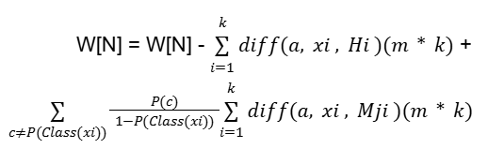
Algorithm: μ-Relief
Requirements: N ≥ 1 ∨ m ≠ 0
To ensure: X ∈ R^{N}
W[N] ⇐ 0
i ⇐ 1
while i ≤ m do:
x_{i} = random(X)
find(H)
find(M_{j})
D_{H} , DMj = md(x_{i}, x_{r})
compute(μ_{iH} ), compute(μ_{iMj})
D_{H}* = D - μ_{iH} ,D_{Mj}* = D - μ_{iMj}
farthest_neighbour(D_{H}* , k), farthest_neighbour(D_{Mj}* , k)
a=1
while a ≤ N do:
a ⇐ a + 1
end while
i ⇐ i + 1
end while

Slide 6
Inverted μ-Relief
Core Concept:
Inveirting Relief to mine for confusion instead of quality, using the Relief Score(W).
From μ-Relief we get W[N] for each of the features of a class, where,
High W: Features that can be used to clearly separate classes
Low W: Feature is noisy and results in confused classification of classes
Inversion:
Focus on points instead of whole features of a class
Focus on hard points(low relief score(W)) instead of easy to determine points to get better results.
Looking for points with Low Relief score to find k-nearest Hits and k-nearest Misses that are nearly indistinguishable. These hard positives are identified via a metric of risk score (R_{risk}).

Slide 7
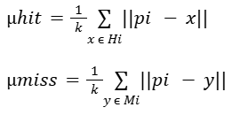

Mathematical Formulation
Calculate local geometric confusion (G_{conf})
For any p_{i} ∈ P with class label ‘C’:
Find H_{i} and M_{i}
To find outliers (use adoptive μ-Relief):
Confusion ratio- Instead of subtracting we use ratio to determine whether a point is closer to a hit or a miss.

Slide 8
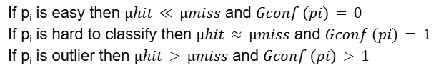


Mathematical Formulation
B. Inversion score for class imbalance
Here, N_{c} is the total count of points for class ‘C’
To find Hard-Prompt score:

Slide 9



Cost matrix
InvMuRFlowchart.png
Modify the cost matrix to be used in Hungarian matcher:
Breakdown:
: Standard distance (L1/L2). It maintains spatial coherence.
: The Inversion. As the relief score decreases (the point becomes harder or noisier), the cost to match it increases significantly.
Result: The Hungarian solver is "forced" to find a good match for the Chair Leg, because failing to do so results in a huge penalty in the cost matrix.

